Slide 1

The DC love affair
By: Rebecca Hale

Slide 2
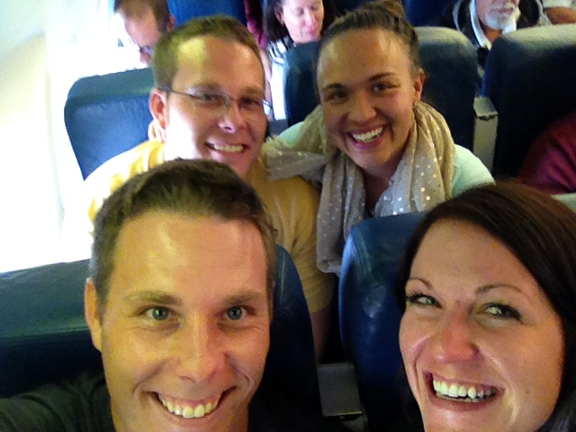
It started with a flight

Slide 3
Tour Agenda
Location | Date | Time | Documents to have
White House Tour | September 5th, 2014 | 7:30 am | Drivers License
U.S. Capital Tour | September 6rd, 2014 | 11:00am | Drivers License
U.S. Treasury | September 7th , 2014 | 8:00am | Drivers License

Slide 4
White house
Nations capital
Metro
Old Town Alexandrea
Capital Bike Share
National Mall
Jefferson Memorial
Lincoln Memorial
Washington monument
Great food
Pentagon
U.S. treasury

Slide 5
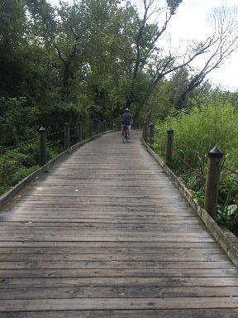
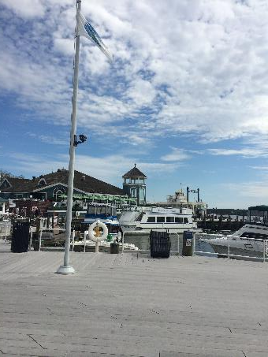
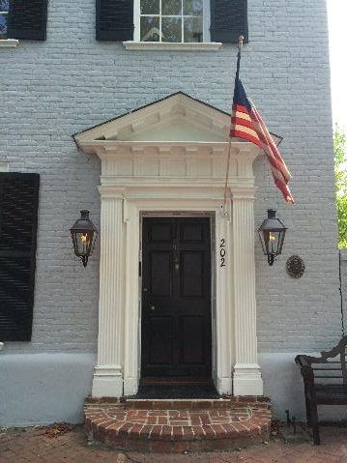
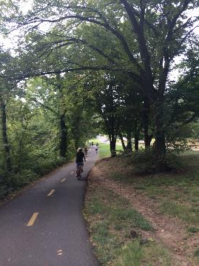
Old Town
Alexandrea

Slide 7
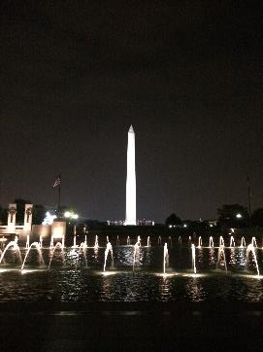
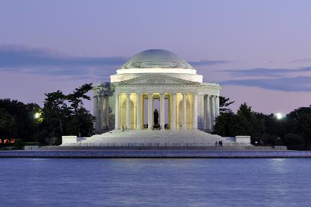
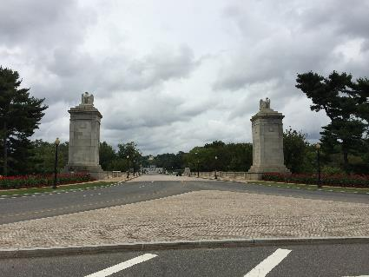
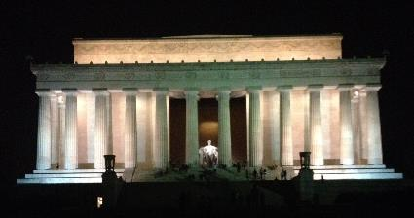
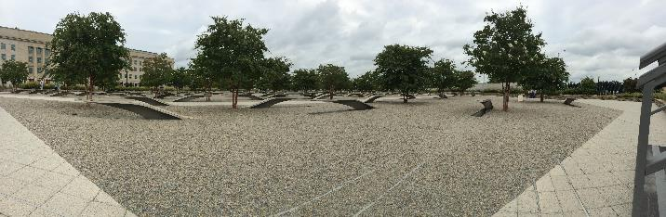

Slide 8
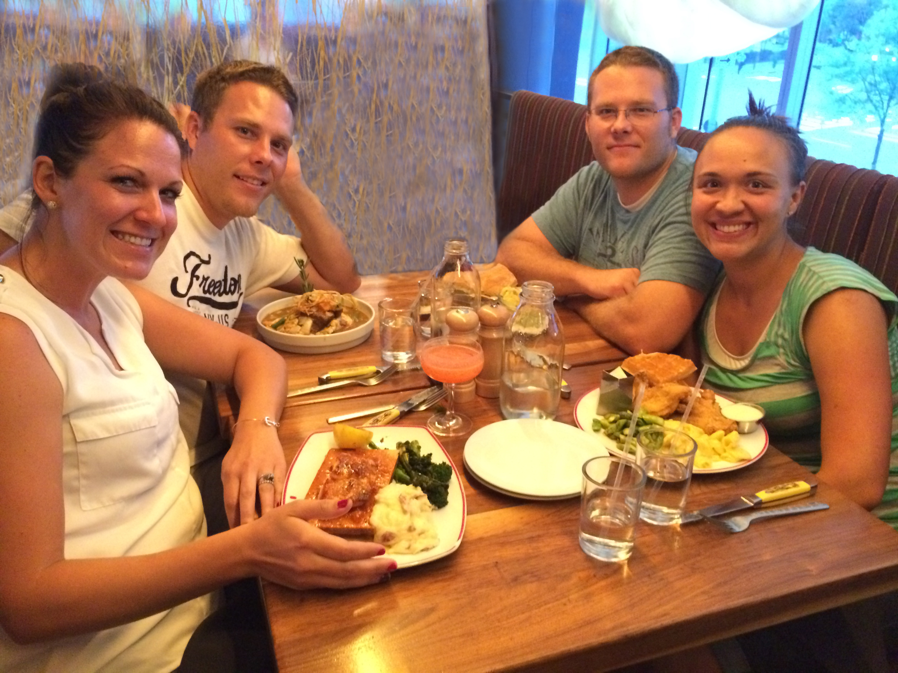
Until we meet again…..

